Slide 1


First order ordinary differential equations
REDUCEABLE TO SEPARABLE (HOMOGENEOUS EQUATION)
REDUCEABLE TO SEPARABLE (HOMOGENEOUS EQUATION)

Slide 2
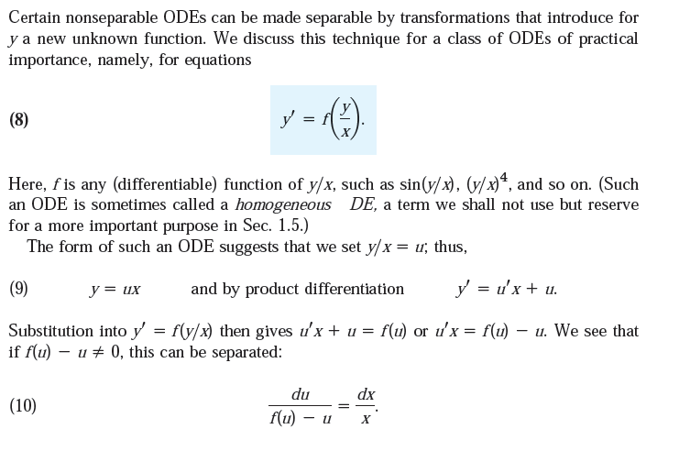

Slide 3
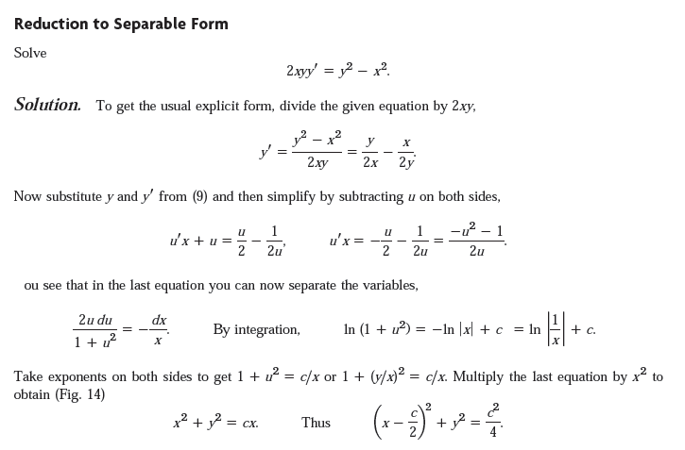

Slide 4
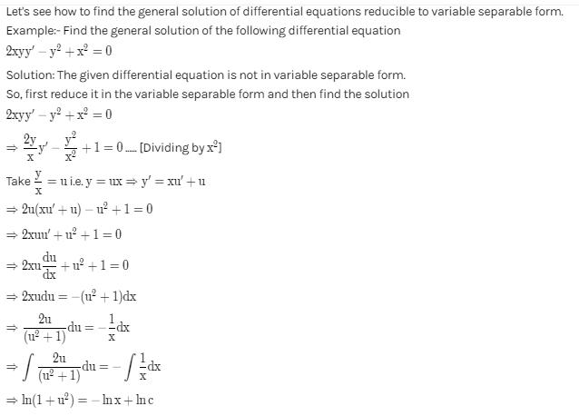

Another Form:

Slide 5
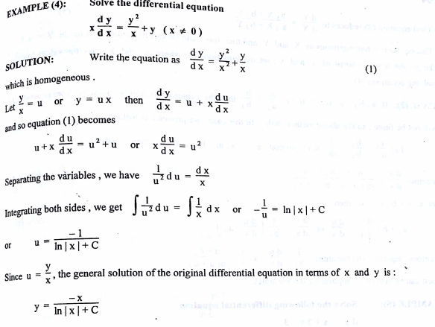

Slide 6
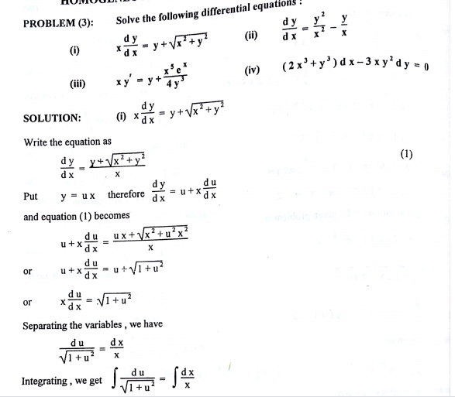

Slide 7
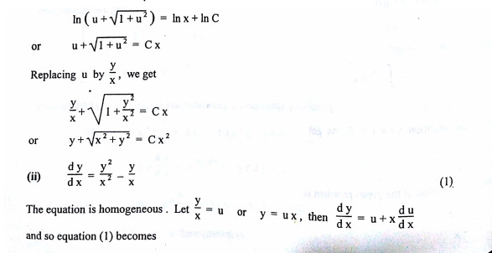

Slide 8
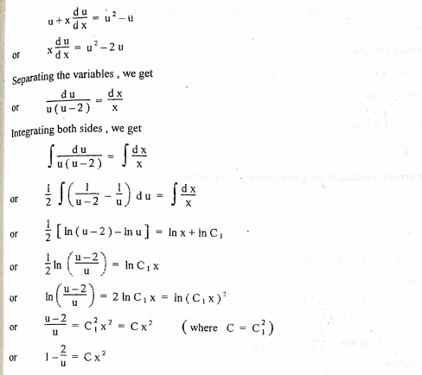

Slide 9
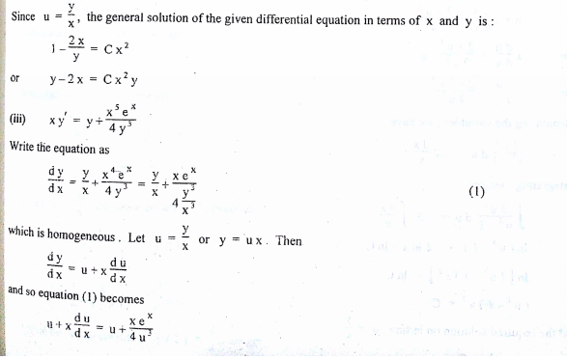

Slide 10
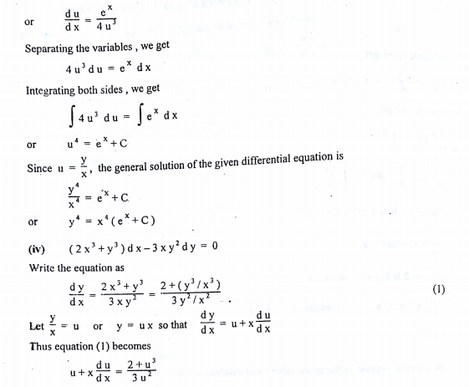

Slide 11
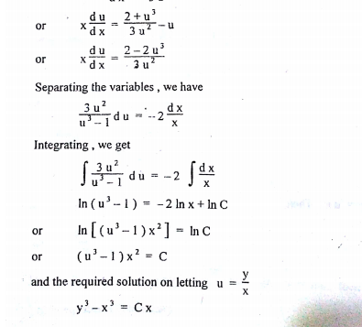

Slide 12
